Slide 1
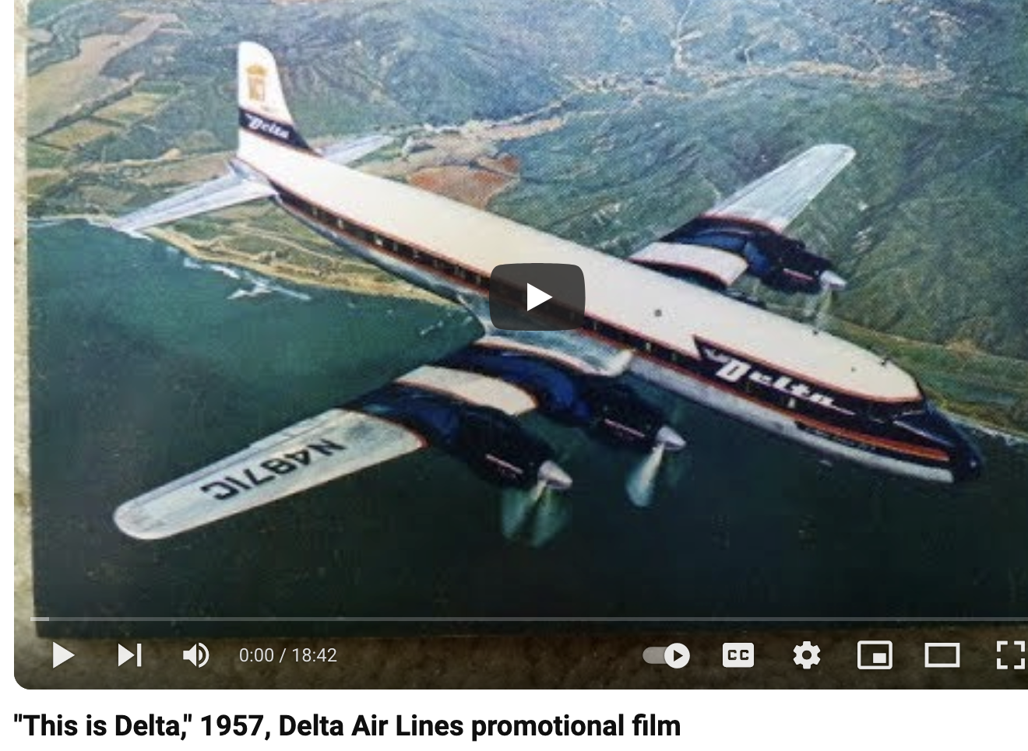
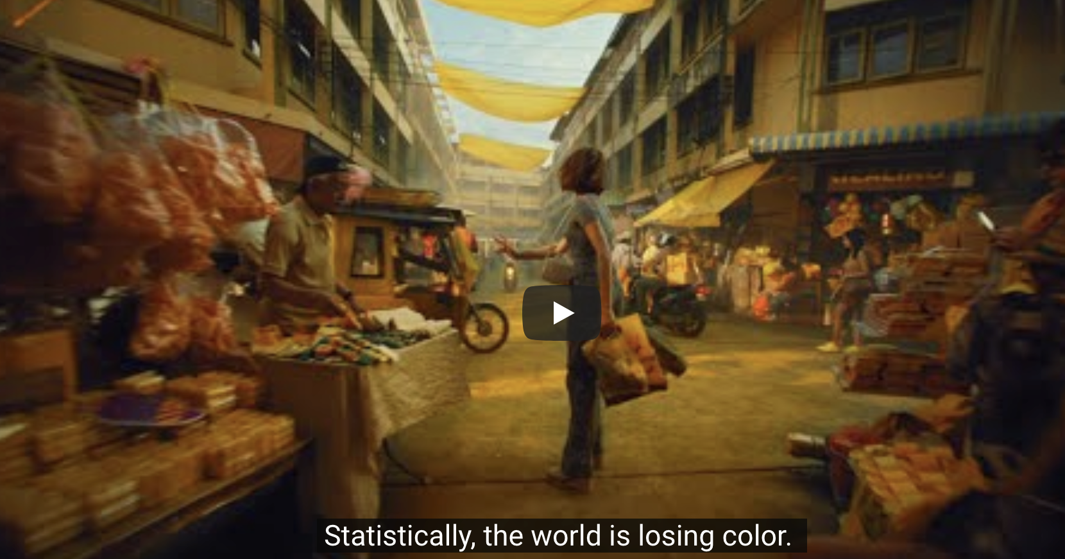
Our rhetorical tools …
Last time, we used Rowe’s method of exploring a claim by replacing one word or concept with another. This time, let’s try Schrepfer’s three questions:
How does it function? (Or: What is its goal?)
Who does it benefit?
Where is the power?

Slide 2
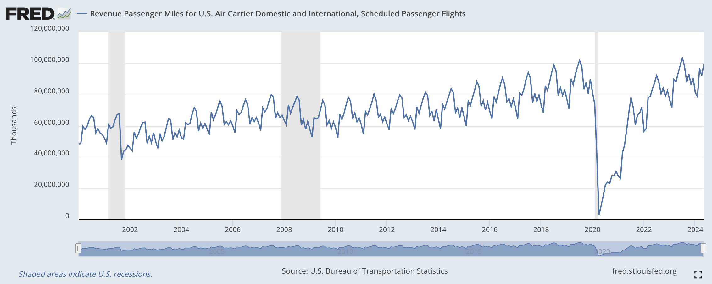
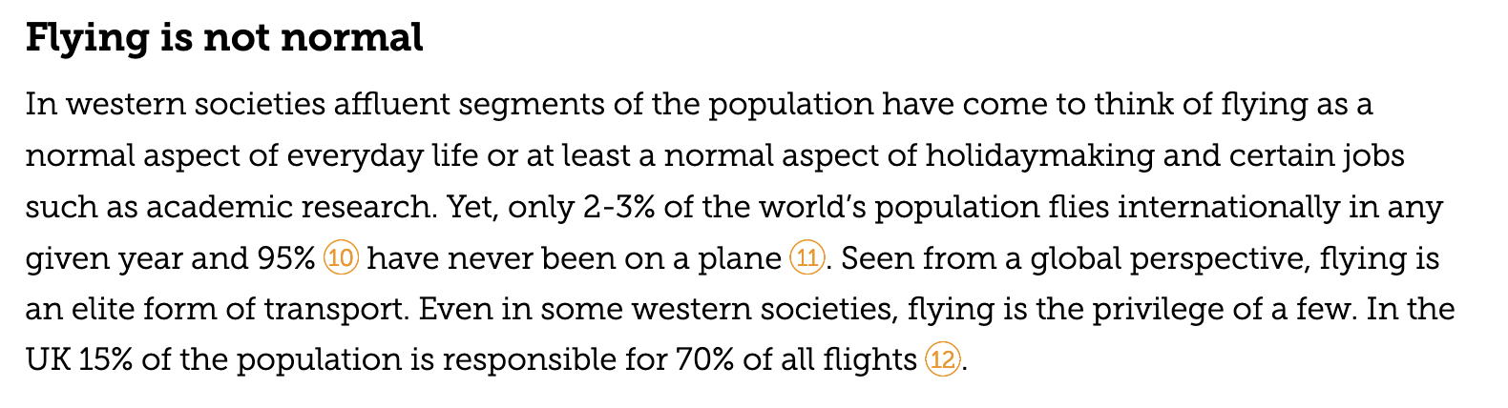
Some interesting facts about flying

Slide 3
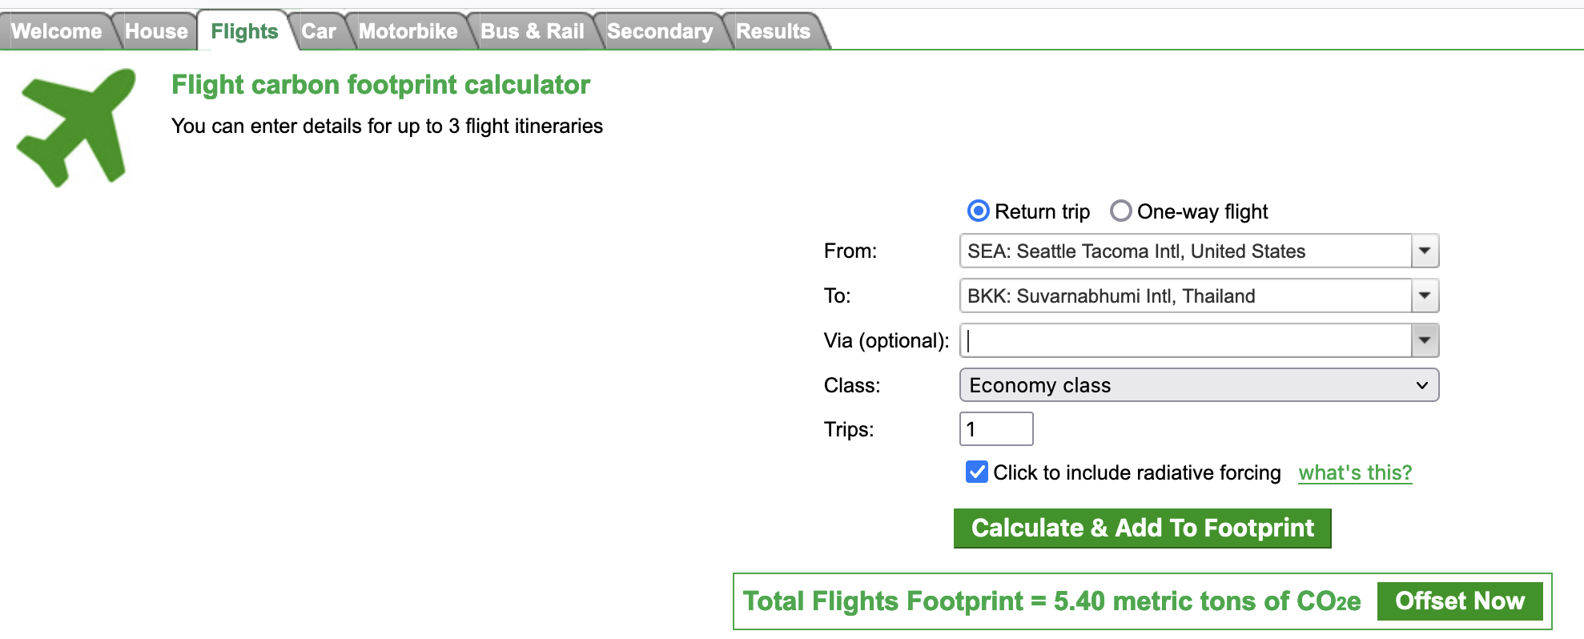
The climate impact of flying … we can quantify the CO₂

Slide 4
The climate impact of flying … we can quantify the CO₂
Is 5.4 metric tons a lot?

Slide 5
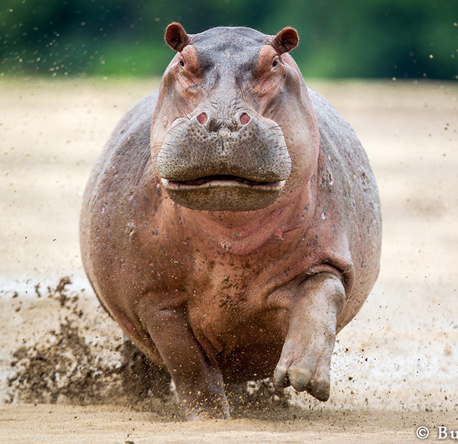
The climate impact of flying … we can quantify the CO₂
Is 5.4 metric tons a lot?

Slide 6
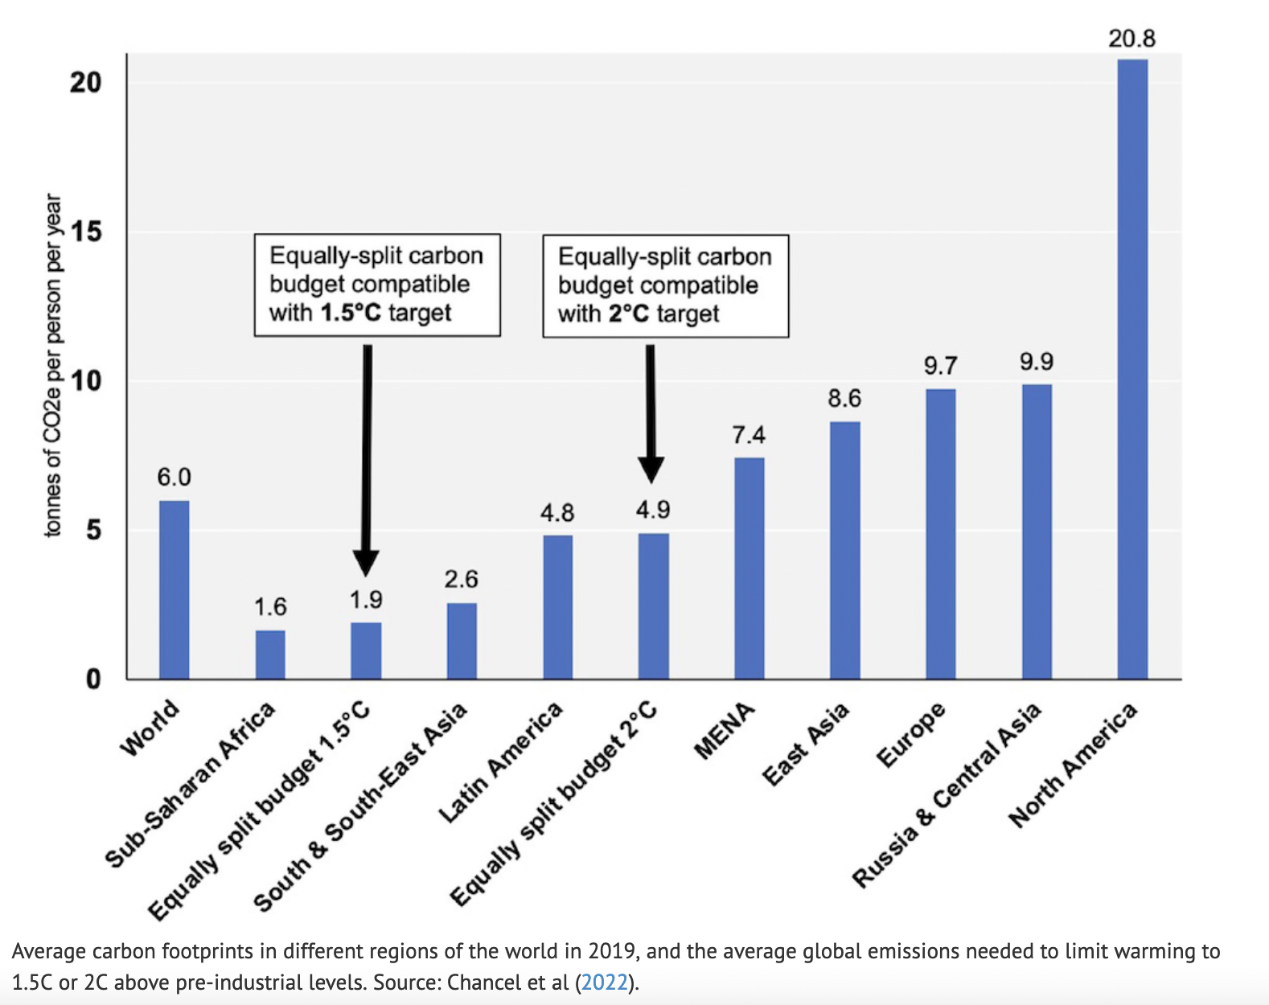
Let’s compare to the per-capita budget needed to avoid $2℃$ warming
Carbon Privilege = 16 GtC/yr
Seatac <-> Bankok

Slide 7

Delta isn’t the only organization that stands to benefit from getting people to fly

Slide 8
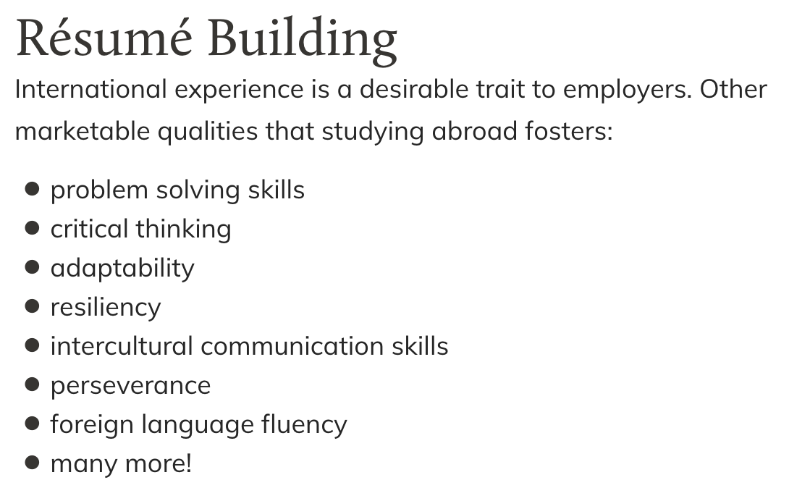
Delta isn’t the only organization that stands to benefit from enticing people to fly

Slide 9
Delta isn’t the only organization that stands to benefit from enticing people to fly
How does it function? (Or: What is its goal?)
Who does it benefit?
Where is the power?

Slide 10
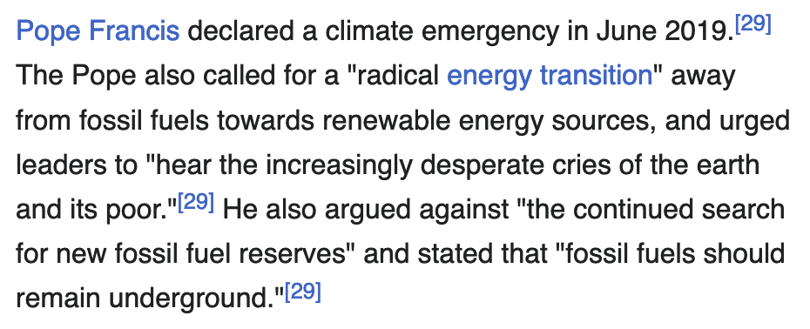
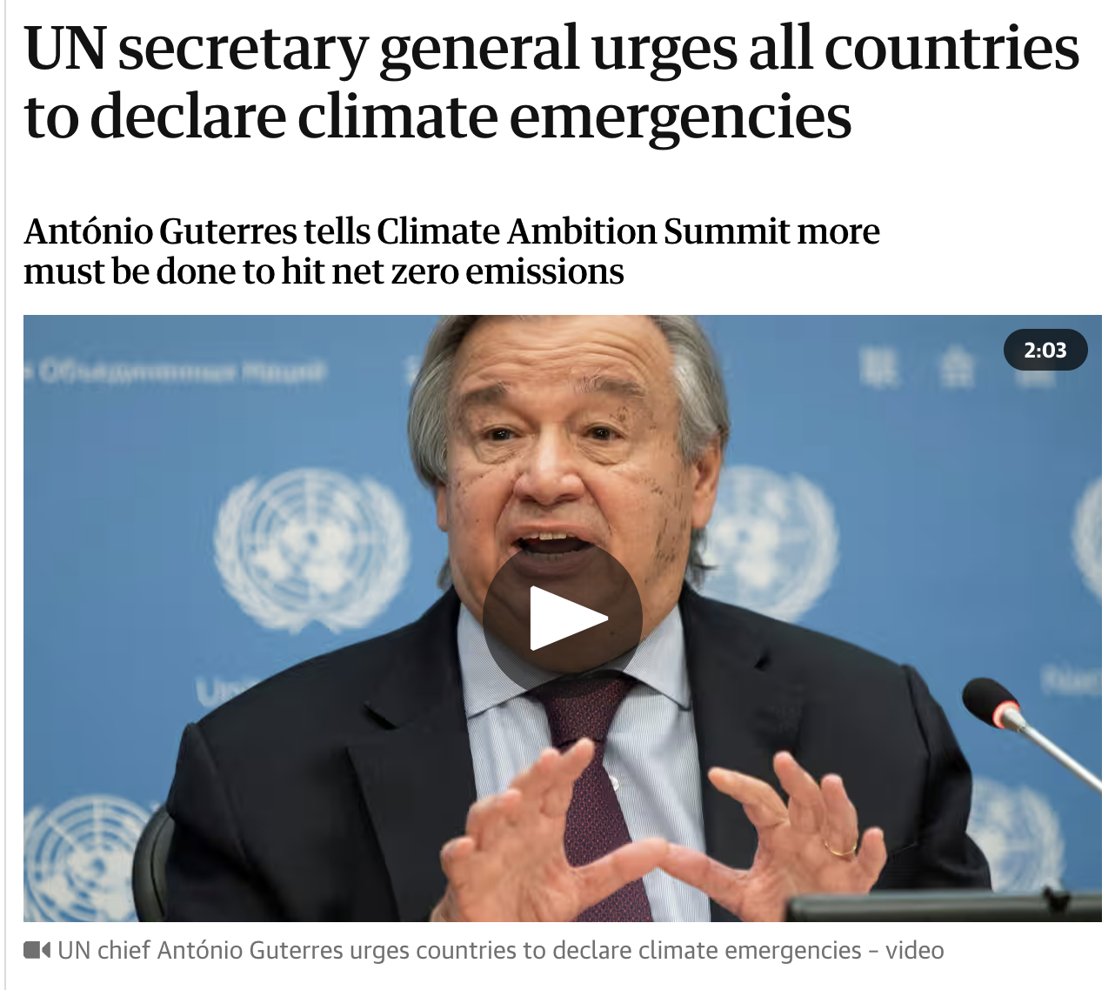
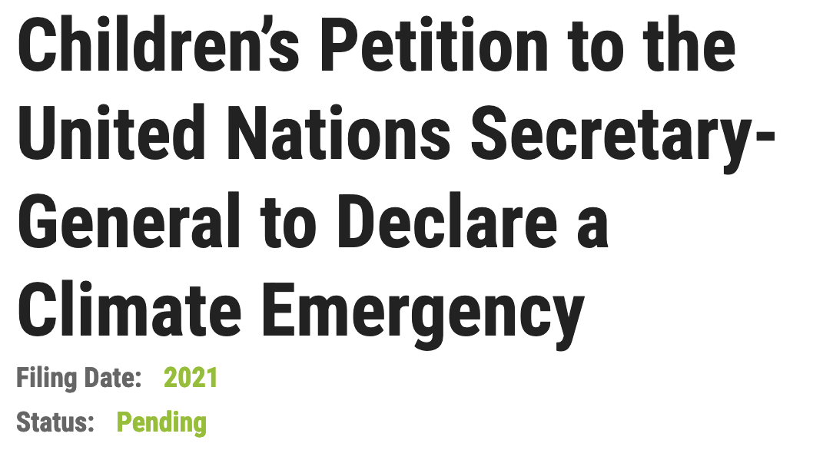
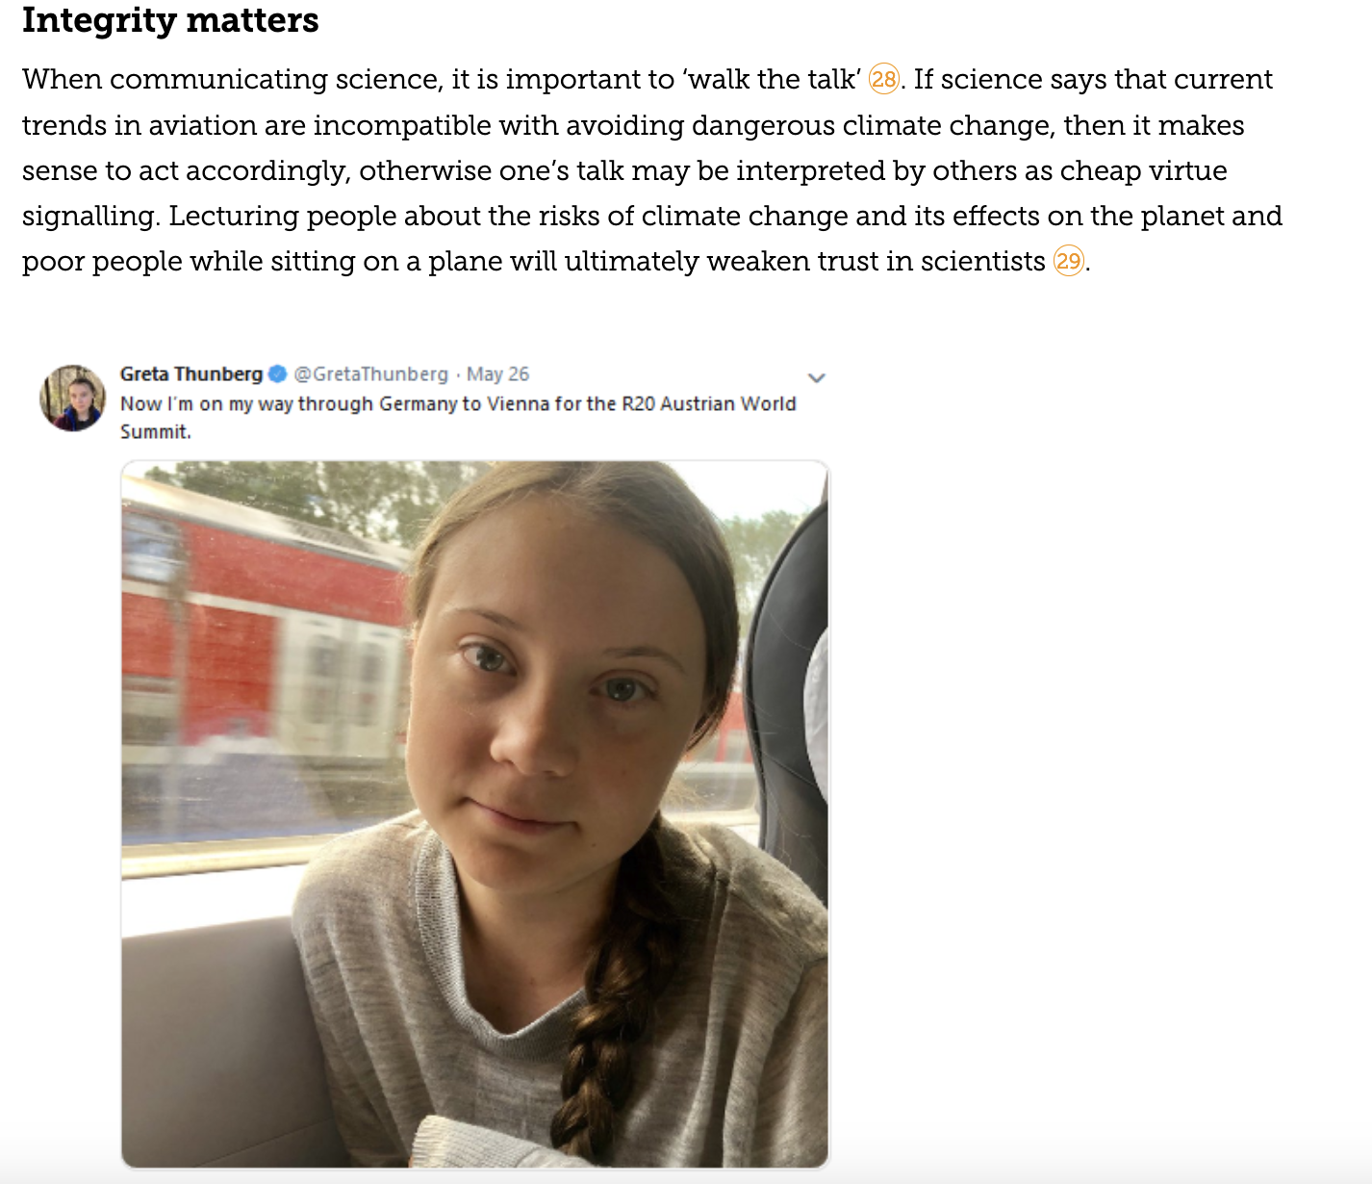
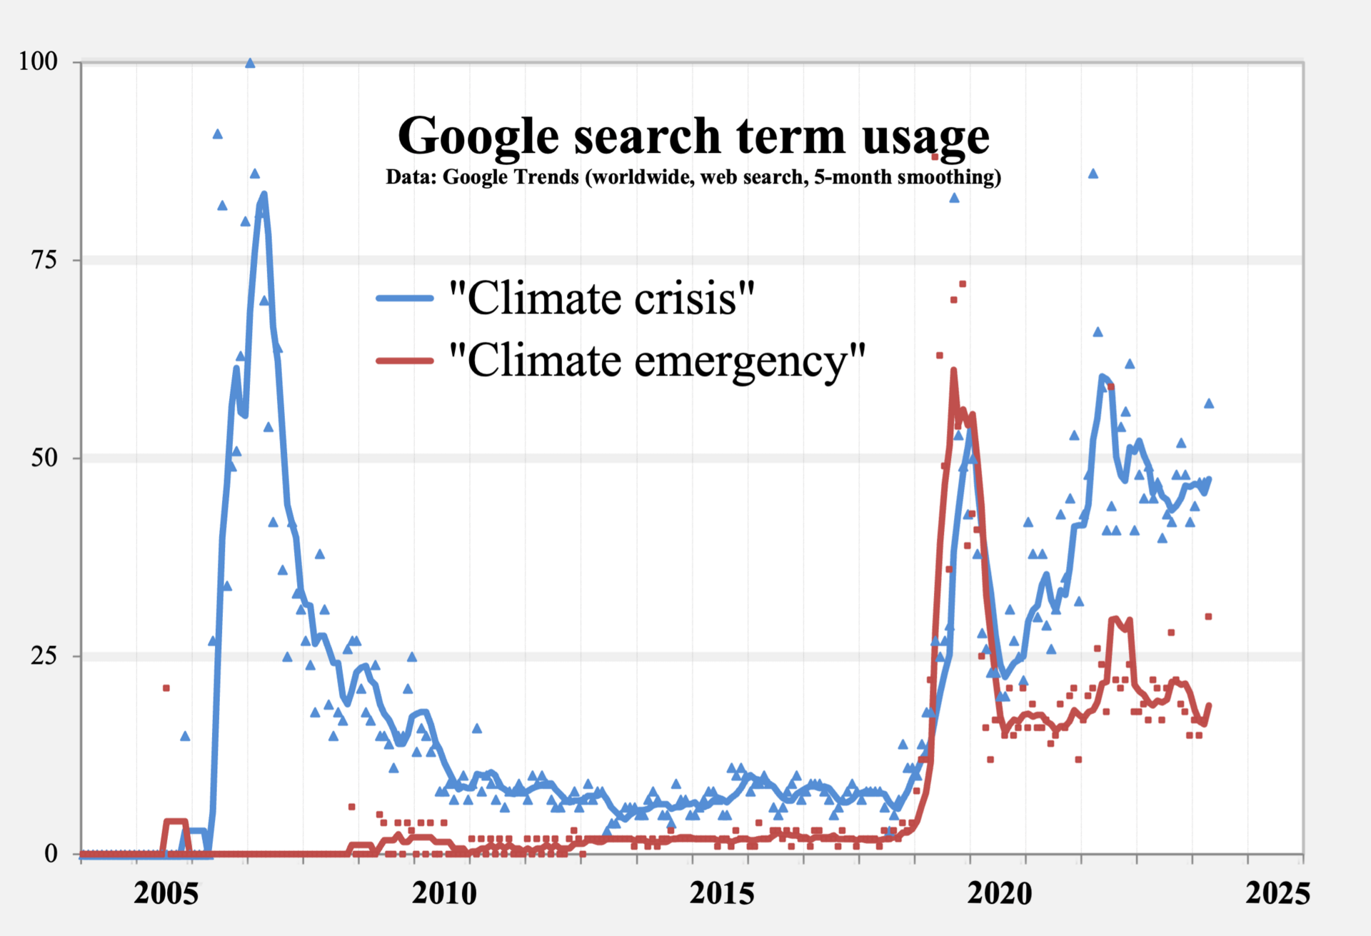

The “Flying Less” movement

Slide 11
The “Flying Less” movement
How does it function? (Or: What is its goal?)
Who does it benefit?
Where is the power?

Slide 12
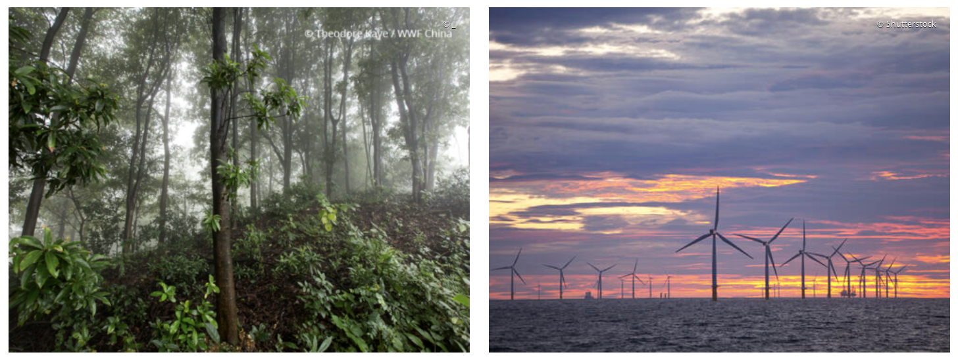
Meanwhile, there’s the IPCC approach: Mitigation would be the best
Climate change mitigation means avoiding and reducing emissions of heat-trapping greenhouse gases into the atmosphere to prevent the planet from warming to more extreme temperatures.
Transition from powering our world with fossil fuels to using clean, renewable energy.
Stop deforestation and restore our natural habitats until we reach net-zero carbon emissions—meaning that the release of greenhouse gases into the atmosphere is balanced with the capture and storage of those gases in places like tree roots.

Slide 13
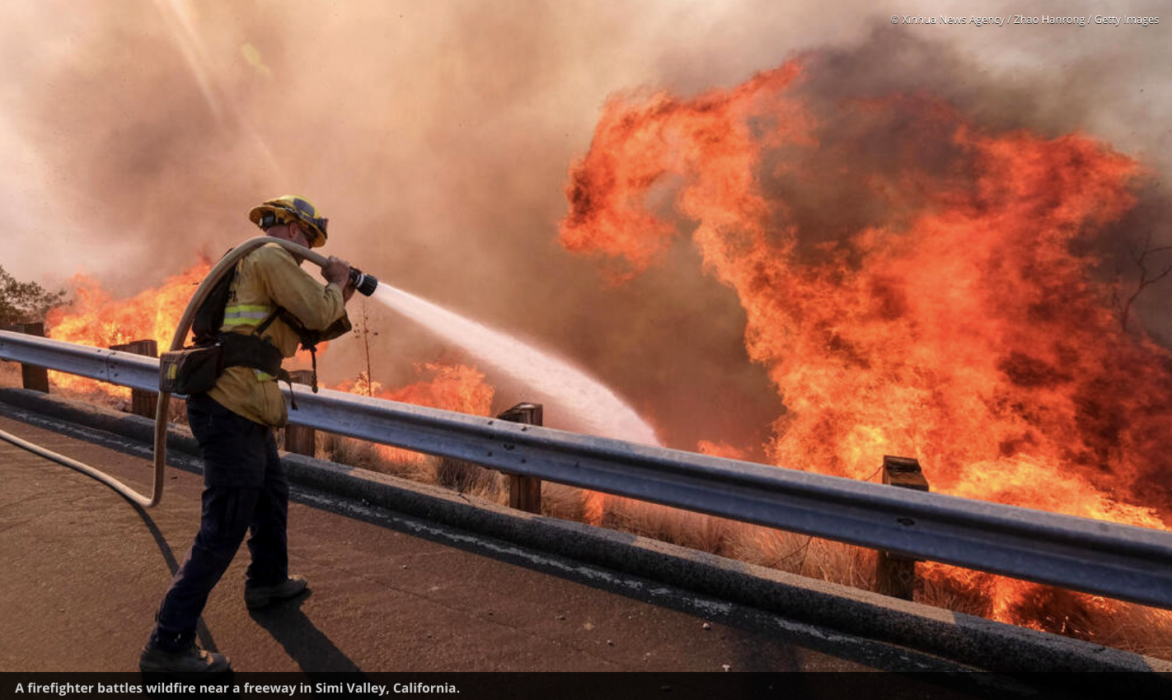
What we can’t mitigate, we’ll have to adapt to
Climate change adaptation means altering our behavior, systems, and—in some cases—ways of life to protect our families, our economies, and the environment in which we live from the impacts of climate change. The more we reduce emissions right now, the easier it will be to adapt to the changes we can no longer avoid.
Examples …
Diversifying crops that can tolerate warmer and drier or wetter conditions
Ensuring infrastructure can withstand more extreme weather
Helping communities reduce their risk from sea level rise and increased floods
Making sure we manage our food, water, and other natural resources wisely in the context of a changing climate.

Slide 14
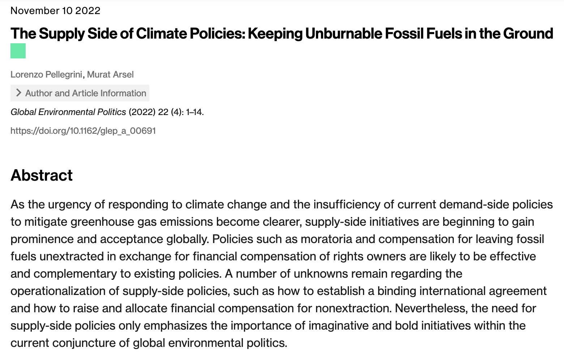
Back to mitigation … There’s Supply-side and Demand-side

Slide 15
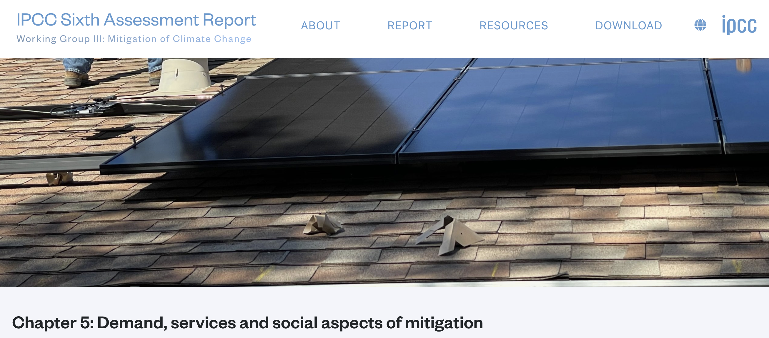
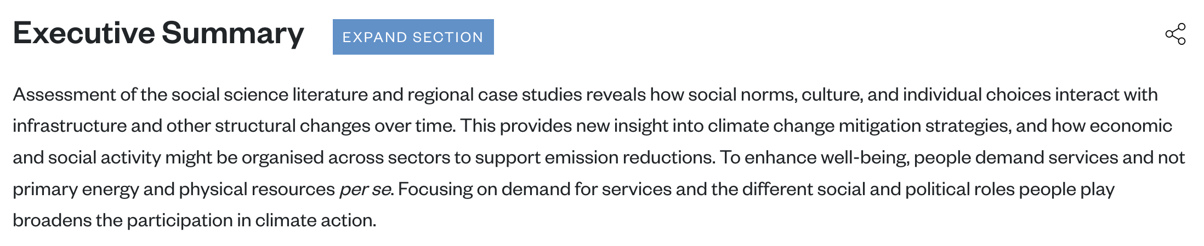
Back to mitigation … There’s Supply-side and Demand-side

Slide 16
But whose demand? We’ve seen big disparities in consumption from country to country …

Slide 17
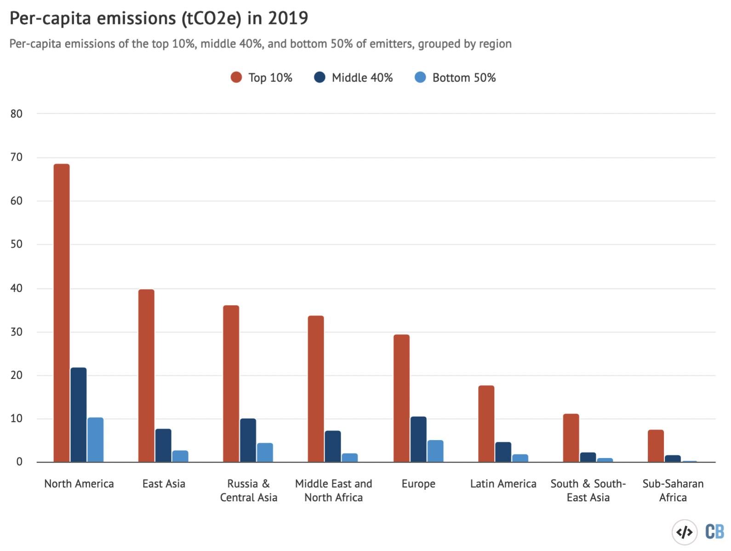
.. and there’s a lot of in-country disparity too

Slide 18
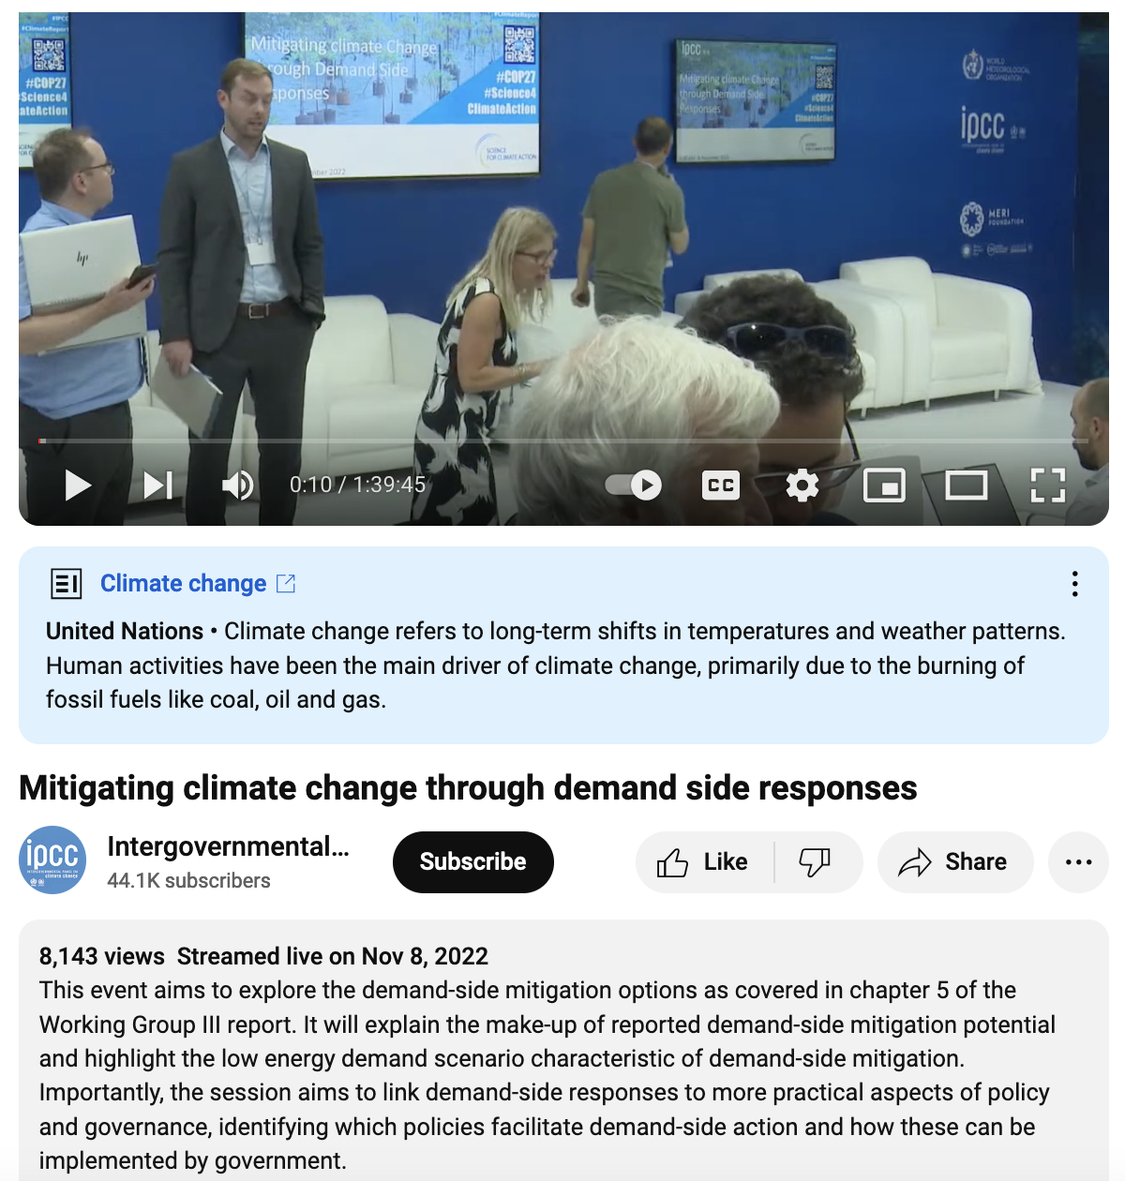
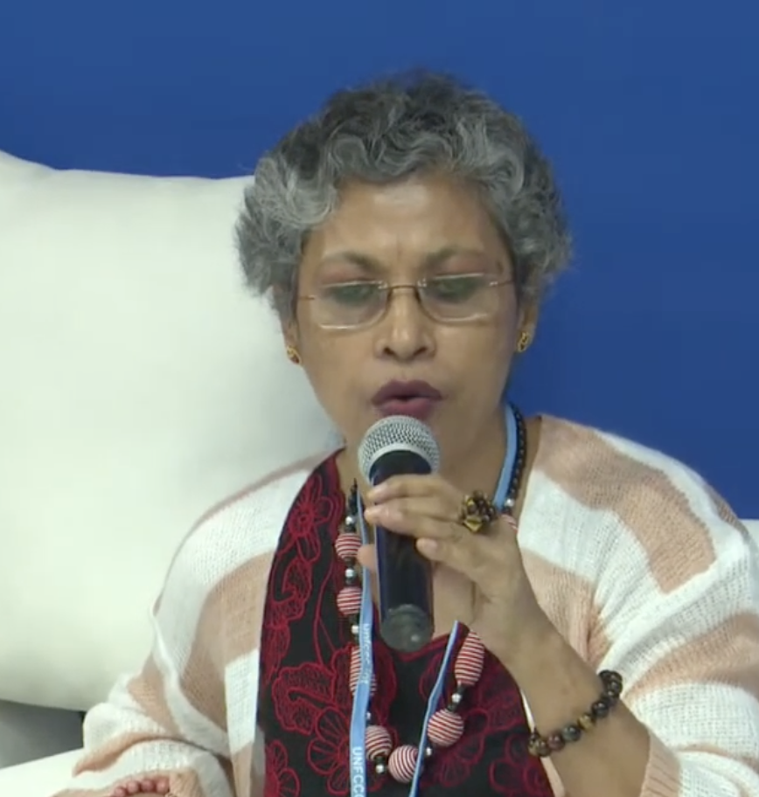
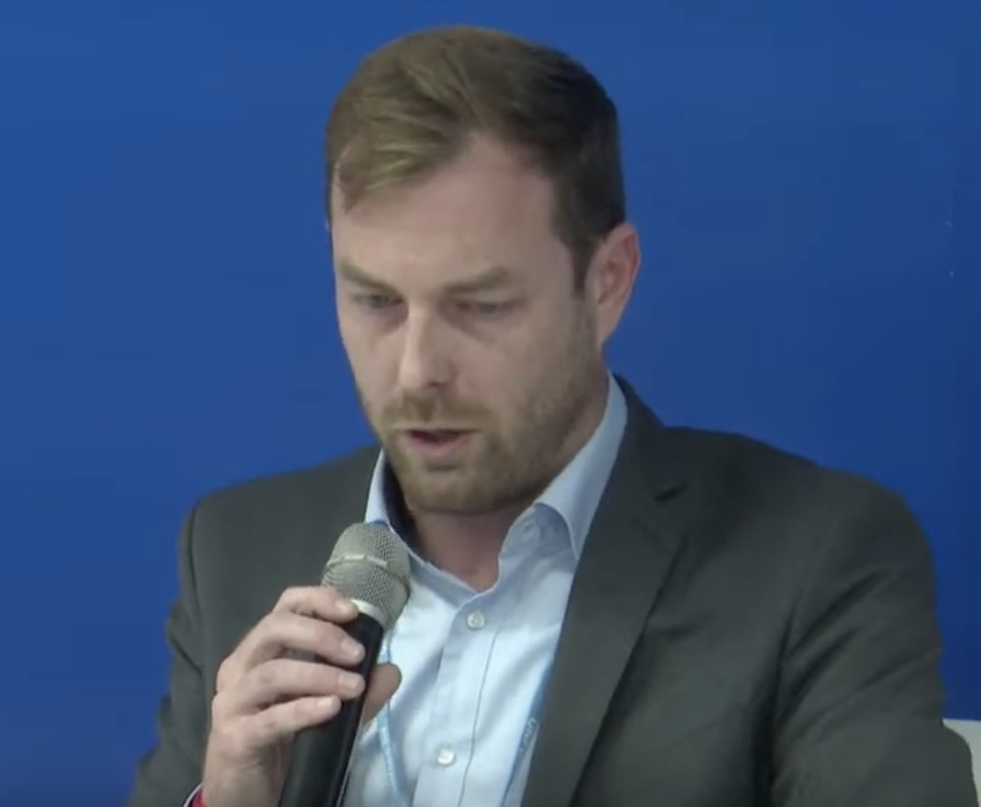
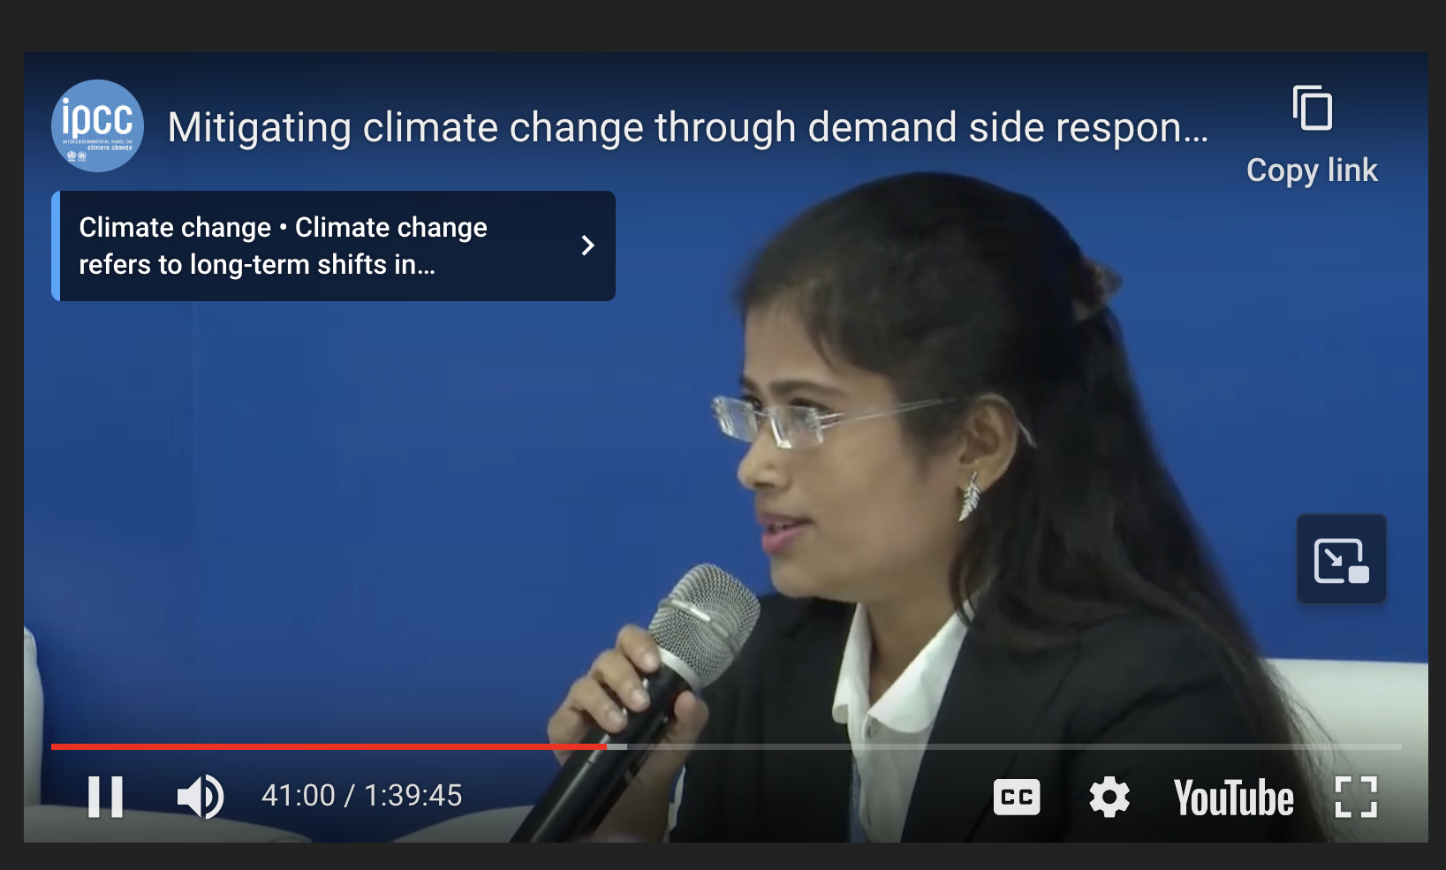
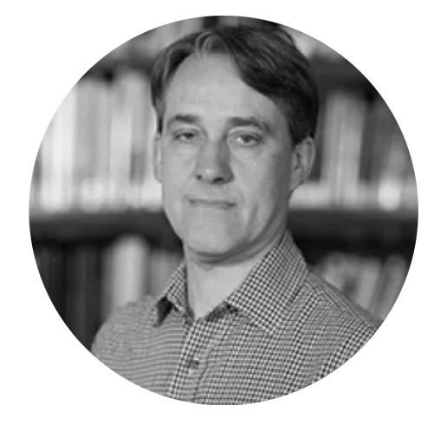
Next discussion assignment: IPCC Panel Discussion on mitigating climate change through demand side reductions
Joyashree Roy, Jadavpur University
David McCollum, Oak Ridge Nat’l Lab
Shreya Some, Asia Institute of Technology
Nick Eyre, Oxford

